Slide 1
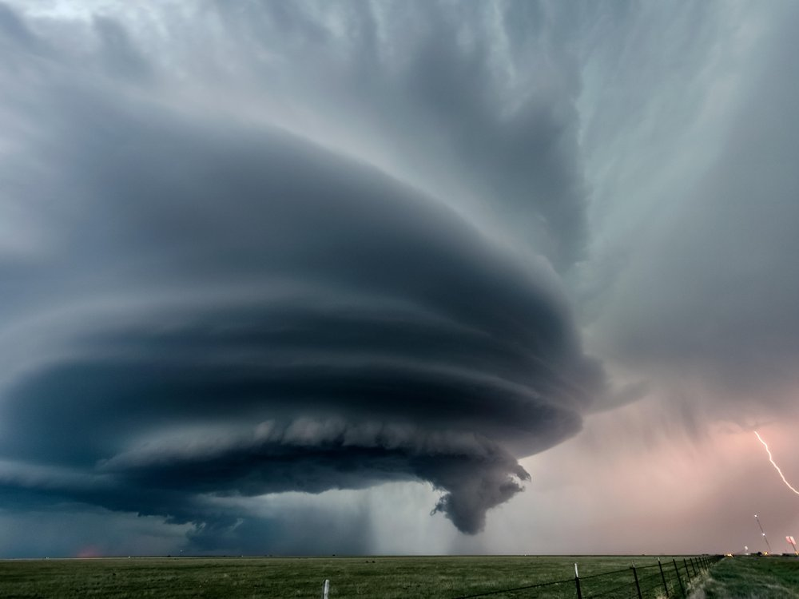
STORMS OVER THE WORLD
DATA SCIENCE AND MACHINE LEARNING
FINAL PROJECT
SAPIR DAGA
ROTEM BEN-TULILA

Slide 2
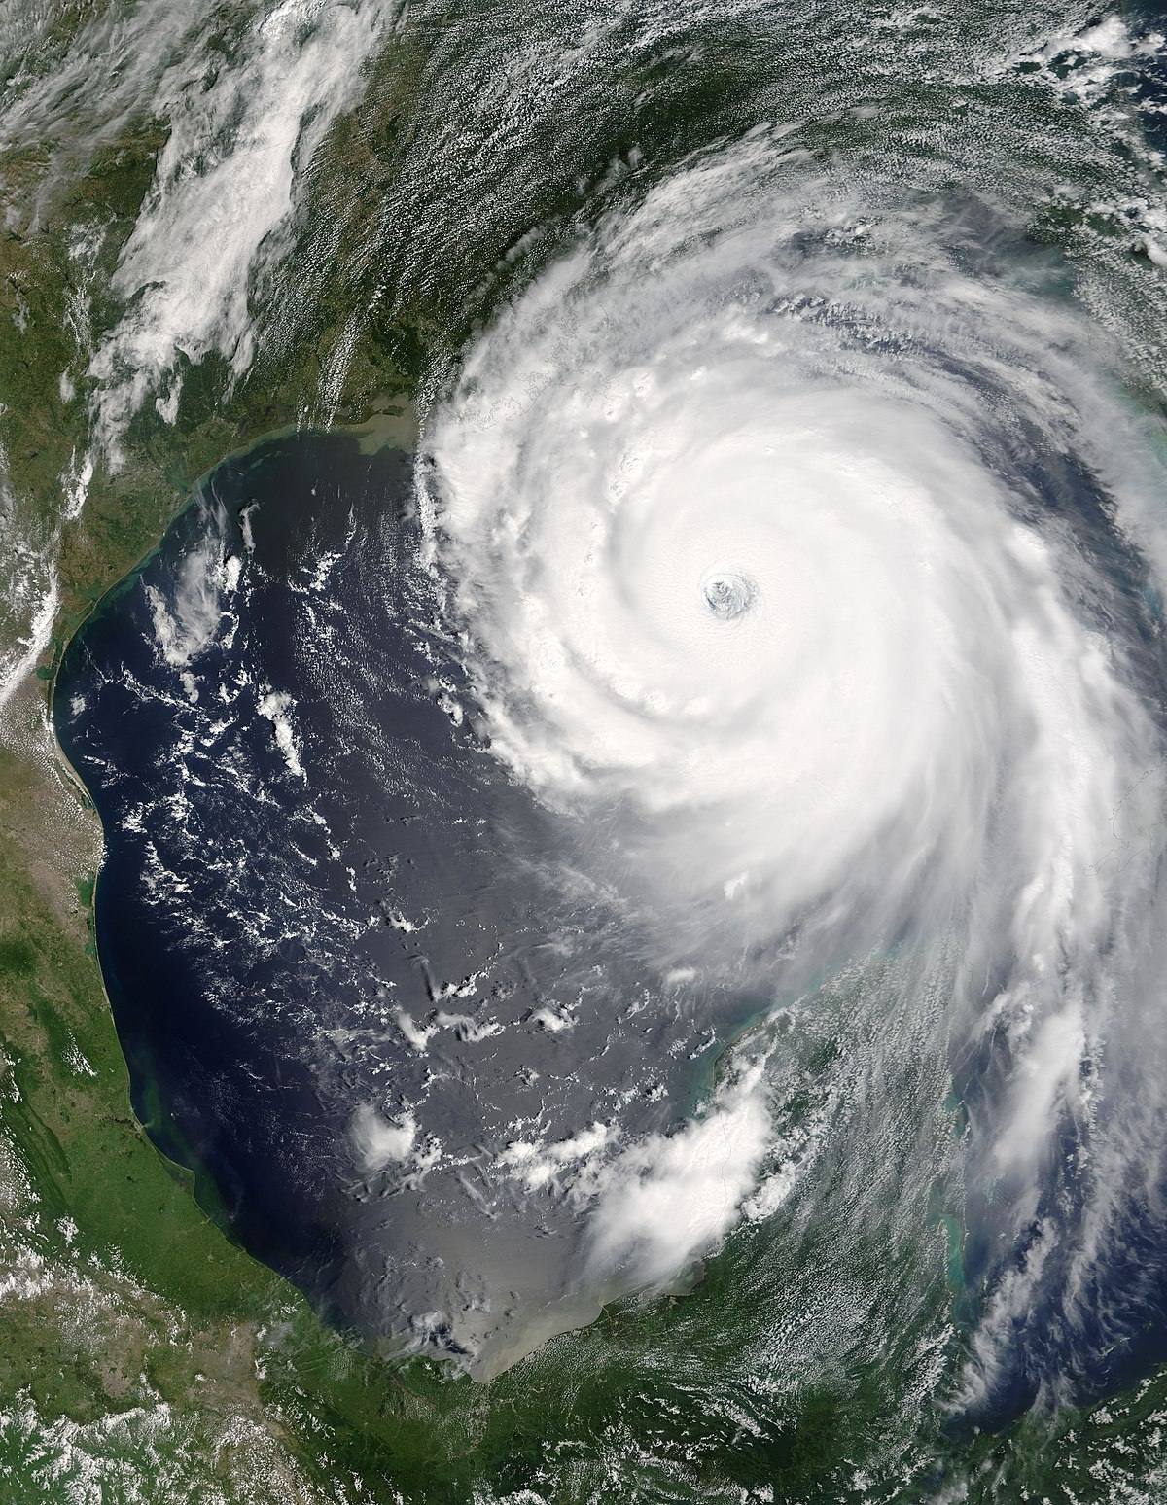

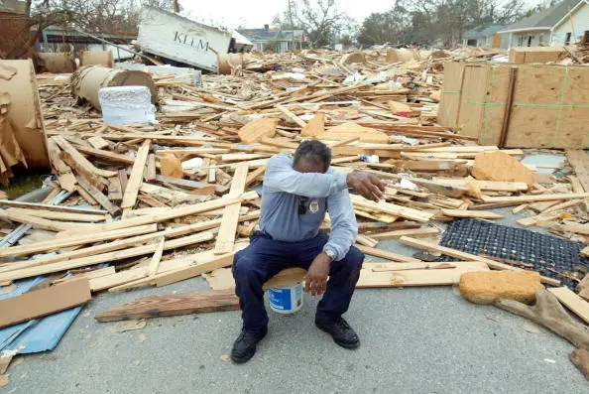
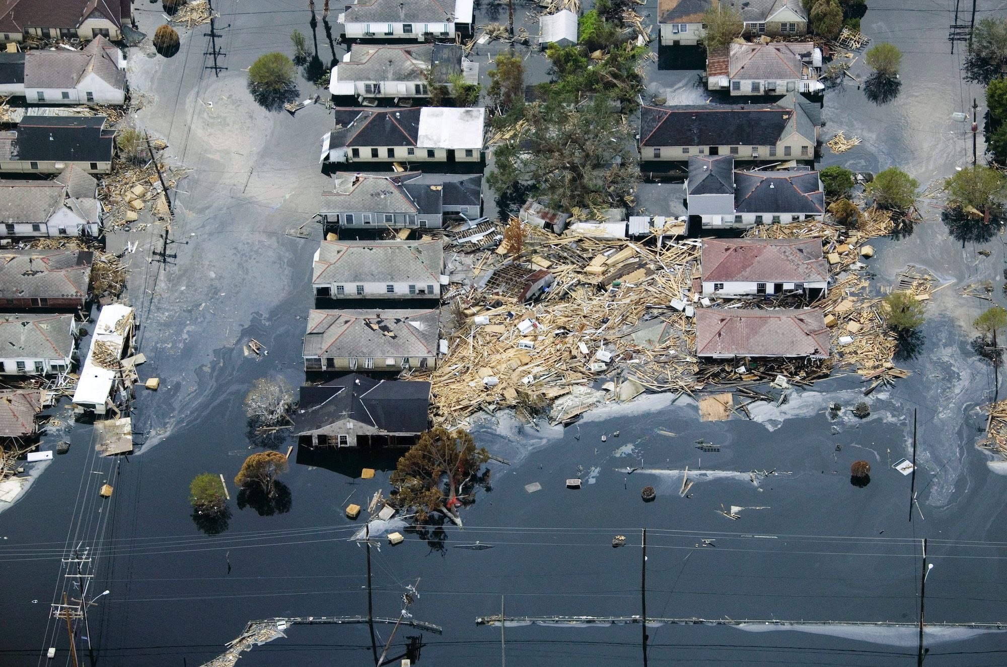
SOME FACTS OF STORMS…
The costliest hurricane to make landfall was Hurricane Katrina, a Category 5 storm that slammed Louisiana in August of 2005. Damages cost an estimated $108 billion. 705 people are reported as still missing as a result of Hurricane Katrina. The final death toll was at 1,836.
When the National Hurricane Center began giving official names to storms in 1953, they were all female. This practice of using only women’s names ended in 1978

Slide 3
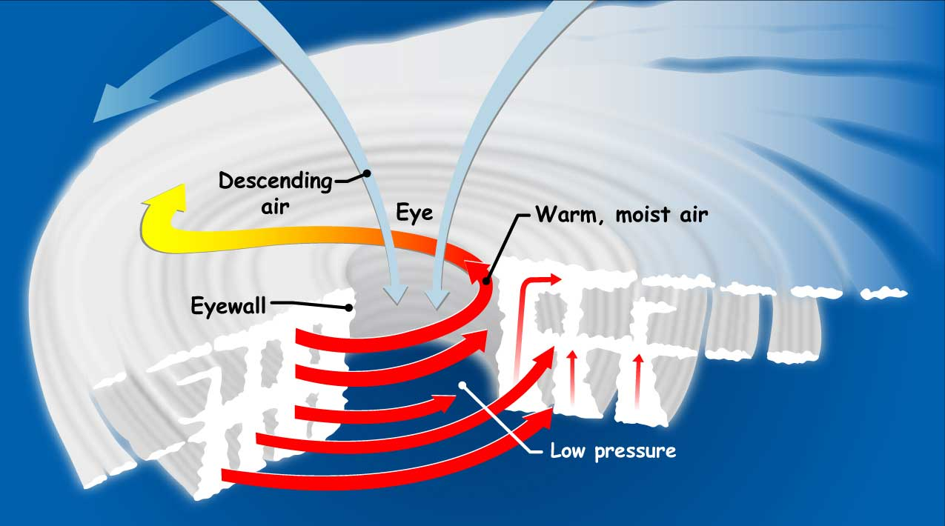

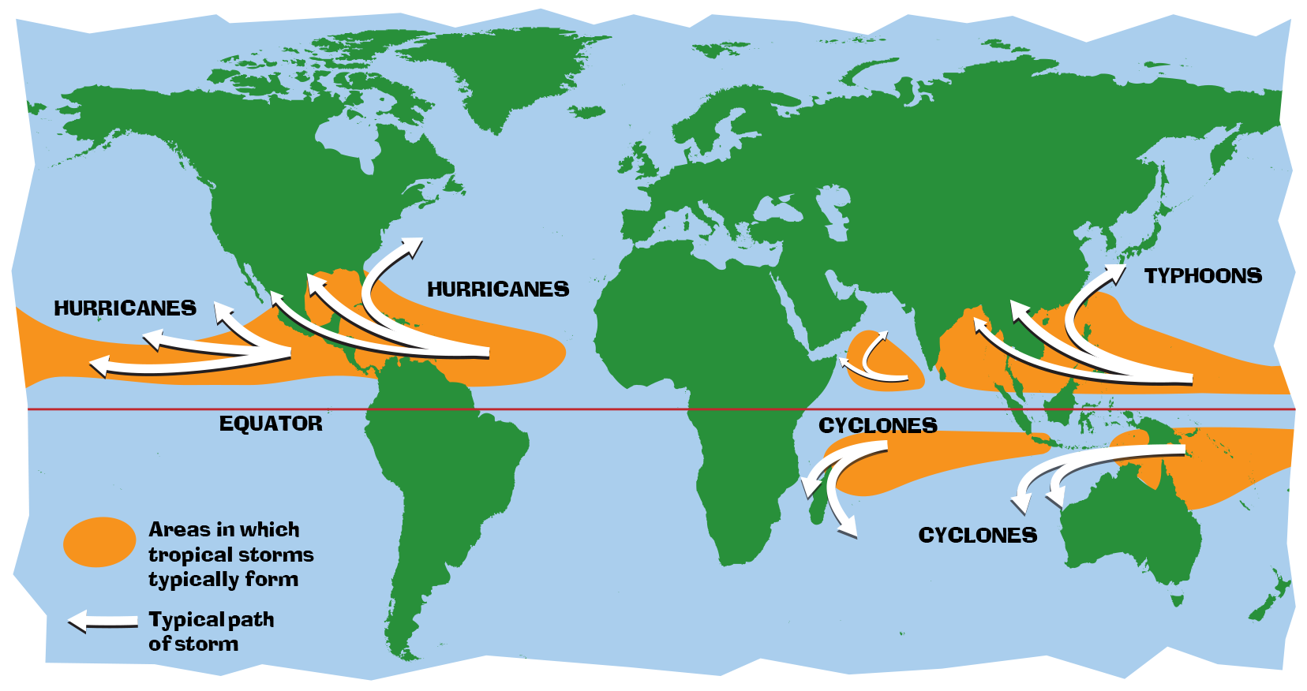
FACTS:

Slide 4
Stages Of Data Science Project
RESEARCH QUESTION
DATA CLEANING
MACHINE
LEARNING
EDA & VISUALIZATION
DATA ACQUISITION
CONCLUSIONS

Slide 5

Our Research Questions :
Is it possible to predict wind power of storm?
It is possible to predict the probability of storm’s strength?

Slide 6
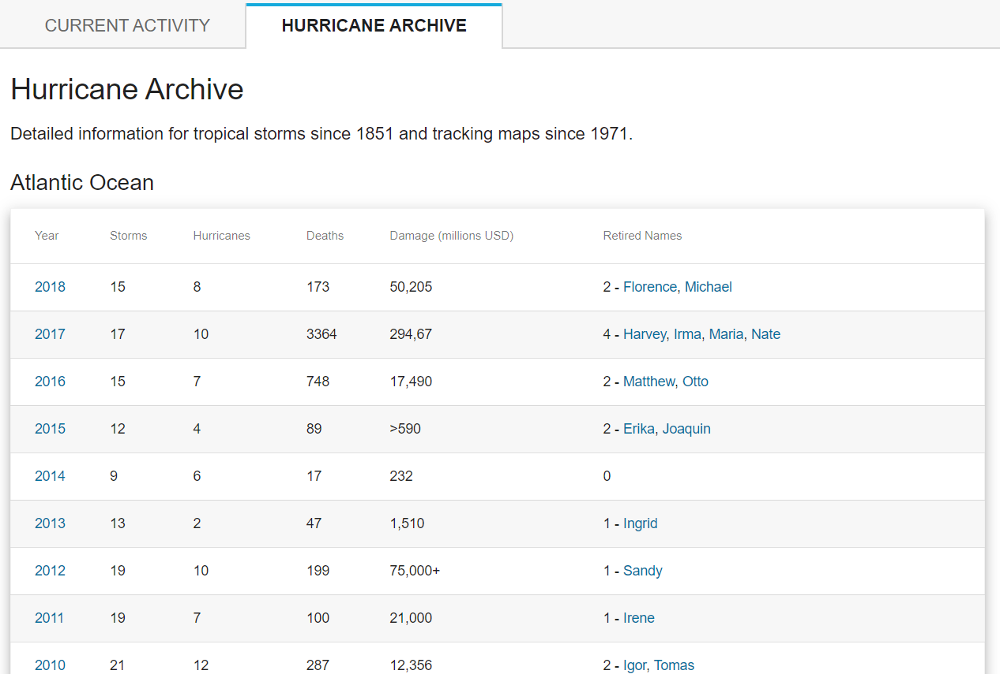

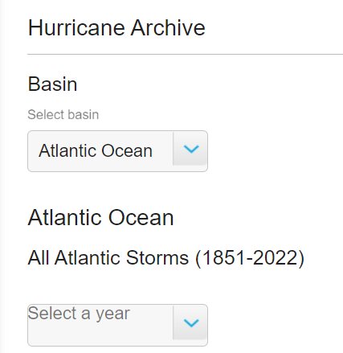
DATA SOURCE
Crawling from
We used :
‘Selenium’ library to reach the dynamic tables and click links automatically.
‘BeautifulSoup’ library to crawl the relevant records of storms.
* Crawling takes 8 hours.
Data acquisition
Data cleaning
EDA
ML
CONCLUSIONS

Slide 7
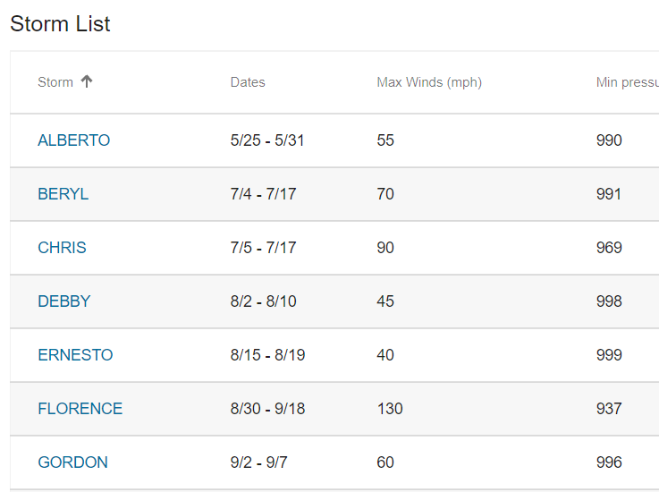
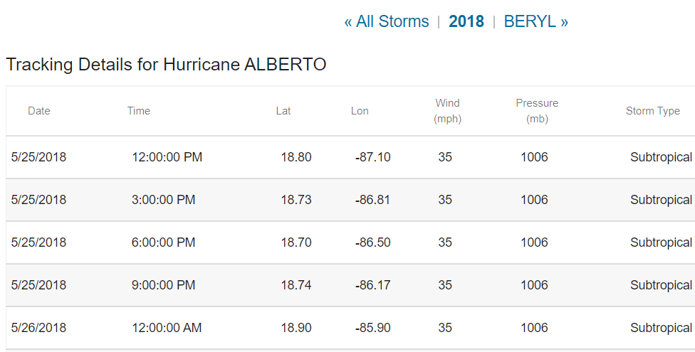
Crawling
We deal with ‘a’ tag without ‘href’ or pattern of the end of URL : -We used click() method of Selenium library -find_element(By.XPATH) method that find link contains the next storm’s name.
Next storm name
First storm of year
Data acquisition
Data cleaning
EDA
ML
CONCLUSIONS

Slide 8
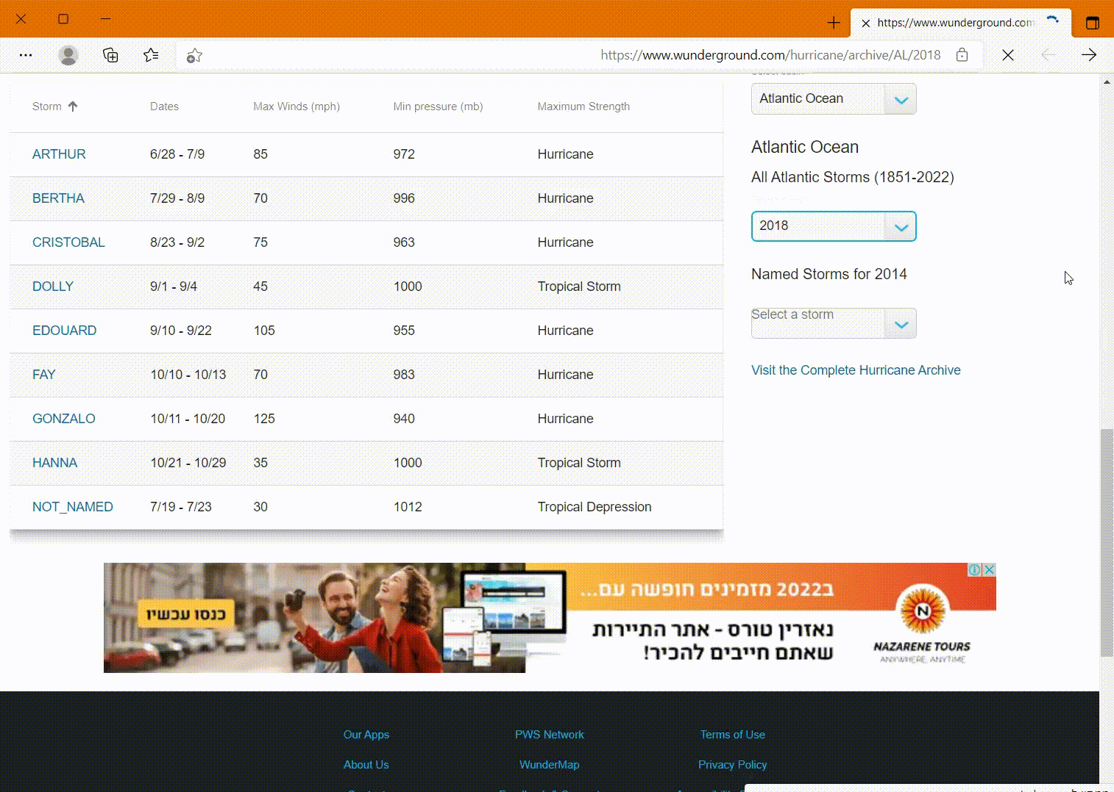
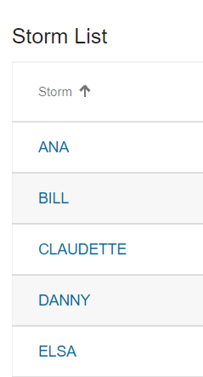
Crawling
We used sleep() to handle with huge amount of requests to avoid time-out and the whole page will be loaded.
Also , When we pass between ‘NOT_NAMED’ storms the URL concat ‘Hurricane’ to the URL
Examples of URLS without pattern -
https://www.wunderground.com/hurricane/archive/AL/2021/Hurricane-Ana/2021139N30302
https://www.wunderground.com/hurricane/archive/AL/2021/Hurricane-Bill/2021165N31281
https://www.wunderground.com/hurricane/archive/AL/2021/Hurricane-Claudette/2021166N20265
Data acquisition
Data cleaning
EDA
ML
CONCLUSIONS

Slide 9
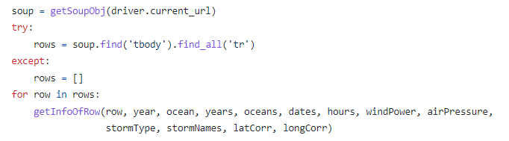
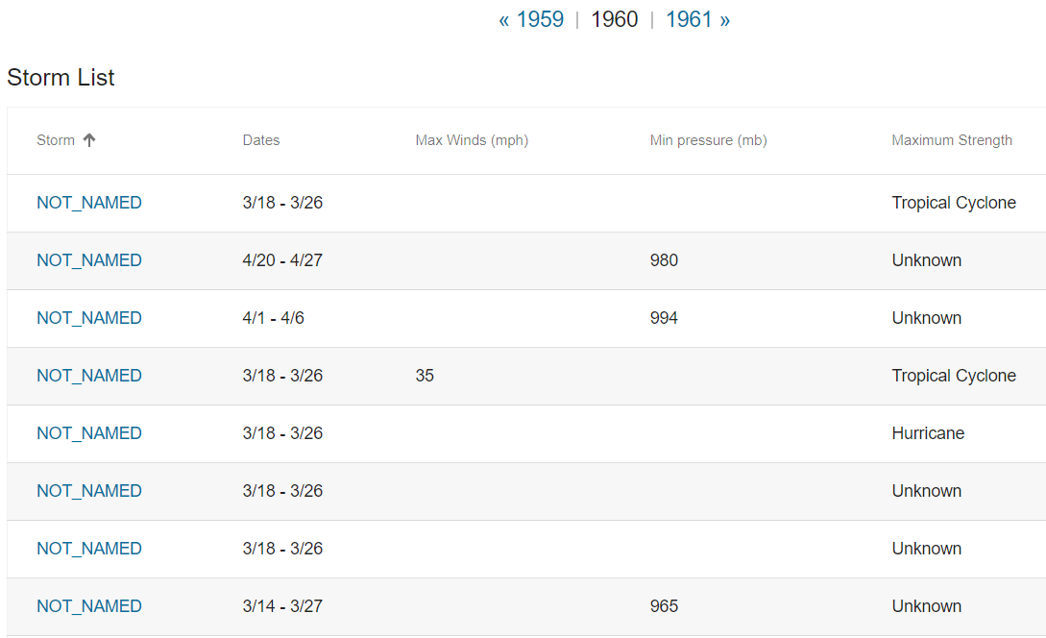
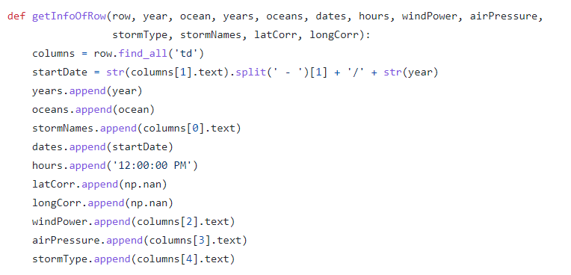
Handaling with NOT_NAMED storms
Tables that started with NOT_NAMED storms - had loop back to the current page - we decided to take data from storms names table.
Data acquisition
Data cleaning
EDA
ML
CONCLUSIONS

Slide 10
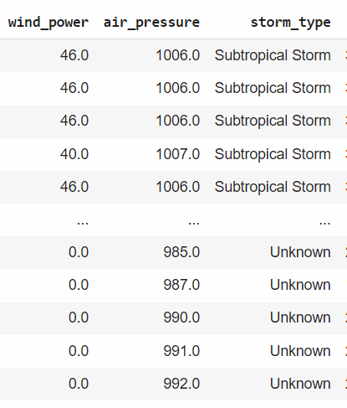
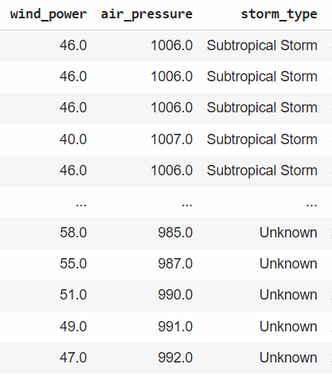
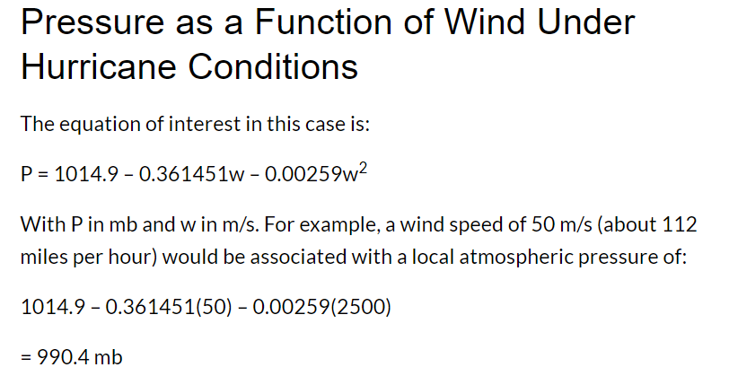
Handling with Missing Values
Cells that had record in ‘air_pressure’ and NaN in ‘wind_power’ - we put value that calculate by formula to convert air pressure to wind power
The formula is specific to Pacific Ocean:
https://sciencing.com/read-digital-barometer-4928057.html
Data acquisition
Data cleaning
EDA
ML
CONCLUSIONS

Slide 11

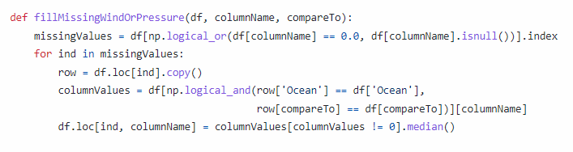
Handling with Missing Values
For other Oceans with cells that had record in ‘air_pressure’ and NaN in ‘wind_power’ - we calculate the median for storms in the same oceans and air pressure because wind power dependent on air pressure.
Data acquisition
Data cleaning
EDA
ML
CONCLUSIONS

Slide 12
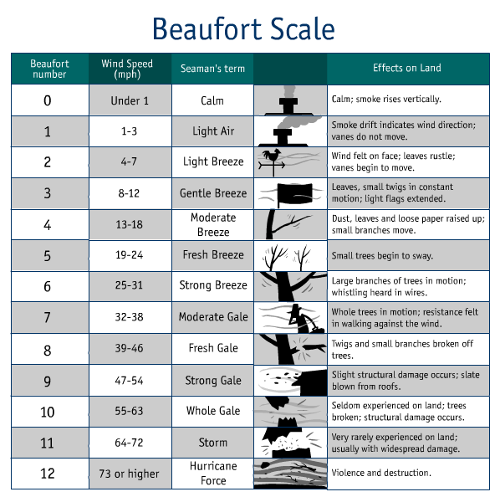
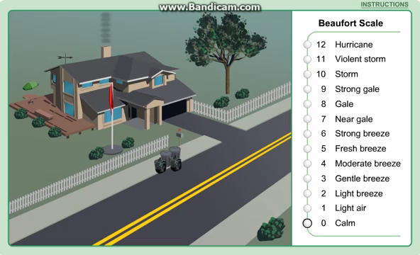
It is a way of estimating the wind strength according to the appearance of the sea.
It is the most widely used system to measure wind speed today.

Slide 13
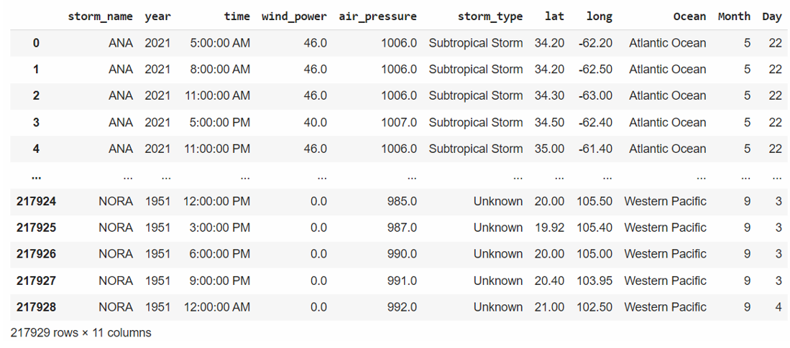
Our DataFrame
Before cleaning
Since ~1950 there is almost no table with records in each ocean - so we decided don't pull the data because of the number of requests that cause the block
Data acquisition
Data cleaning
EDA
ML
CONCLUSIONS

Slide 14
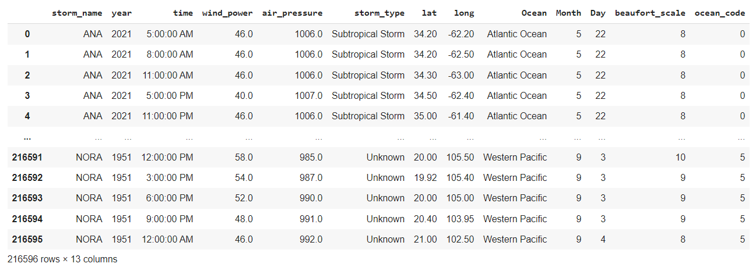
Our DataFrame
After cleaning
* cleaning data takes 18 minutes.
1333 rows has been deleted
Data acquisition
Data cleaning
EDA
ML
CONCLUSIONS

Slide 15
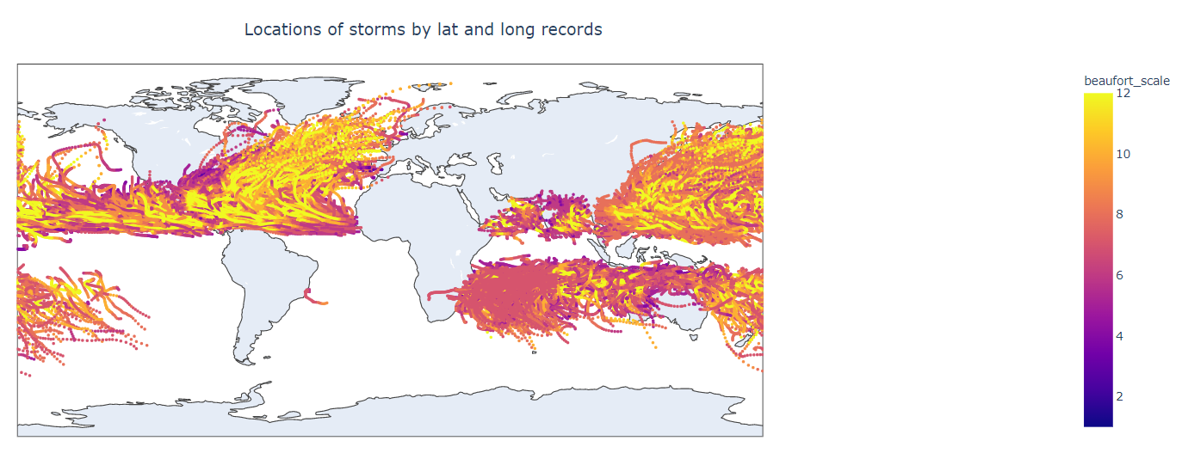
Visualization & Exploring data
Data acquisition
Data cleaning
EDA
ML
CONCLUSIONS

Slide 16
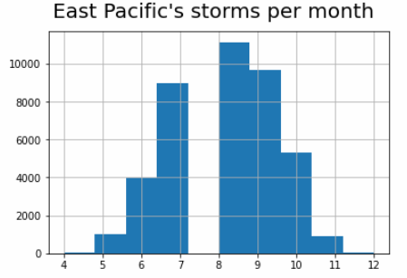
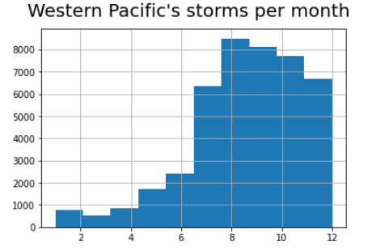
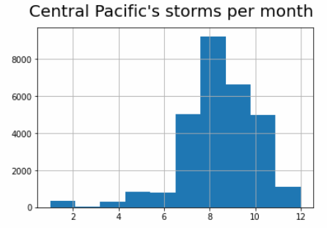
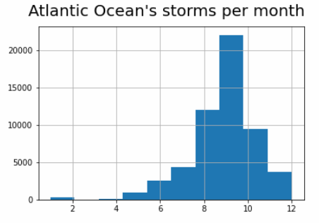
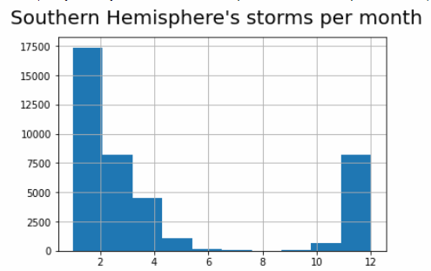
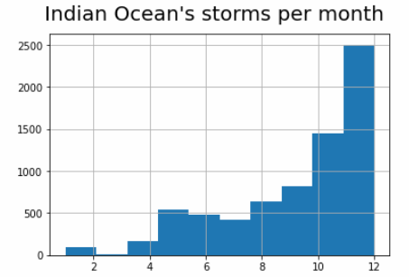
Visualization & Exploring data
Data acquisition
Data cleaning
EDA
ML
CONCLUSIONS

Slide 17
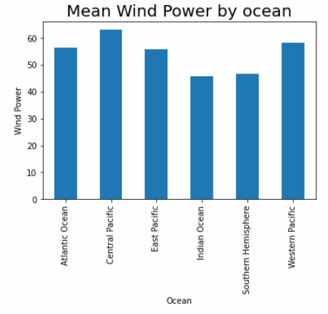
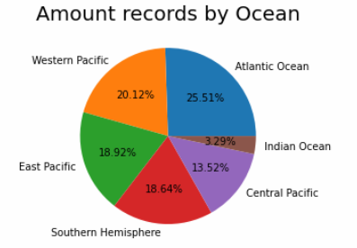
Visualization & Exploring data
We can see that most of the storms is in Pacific Ocean and the least is in Indian Ocean
Data acquisition
Data cleaning
EDA
ML
CONCLUSIONS

Slide 18
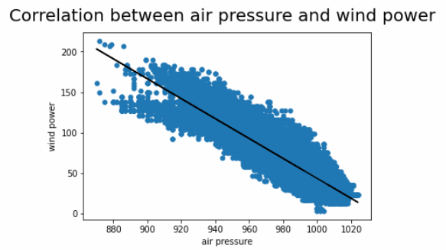
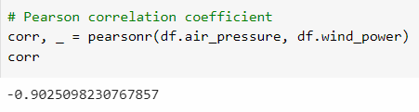
Visualization & Exploring data
We checked the connection between air pressure and wind power
As we can see there is a linear connection between air pressure and wind power
Data acquisition
Data cleaning
EDA
ML
CONCLUSIONS

Slide 19
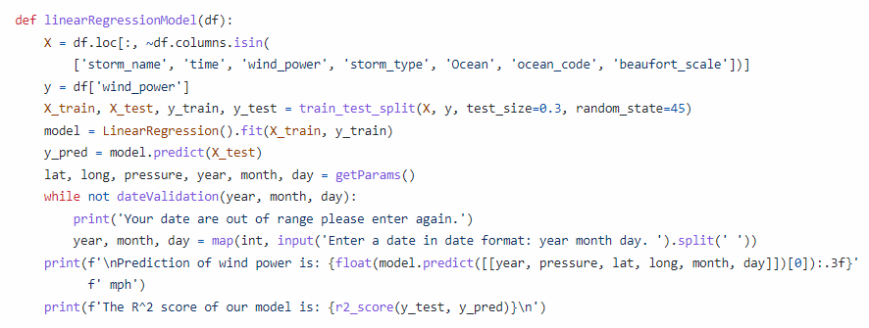

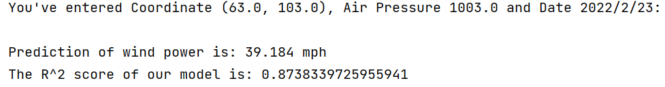
We used sklearn library to classification and regression models
Machine Learning
Linear Regression:
Predict wind power by :
Date, Coordinates and air pressure
Evaluation of model:
Data acquisition
Data cleaning
EDA
ML
CONCLUSIONS

Slide 20
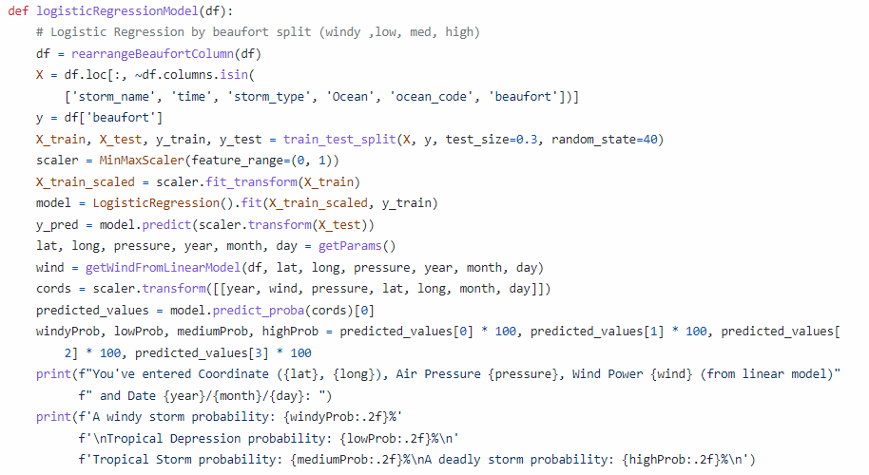
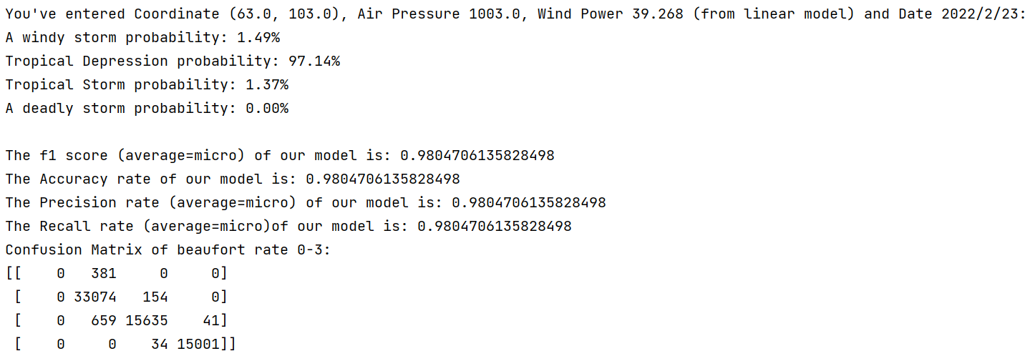

Machine Learning
Logistic Regression:
Predict probability of strength of storm according to beaufort scale by: Date, Coordinates, air pressure and wind power we get from inner linear model.
rearrangeBeaufort() - Classification of storms by Beaufort scale
https://en.wikipedia.org/wiki/Beaufort_scale
Evaluation of model:
Data acquisition
Data cleaning
EDA
ML
CONCLUSIONS

Slide 21
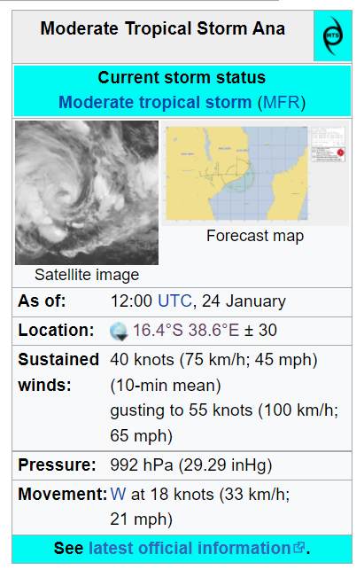
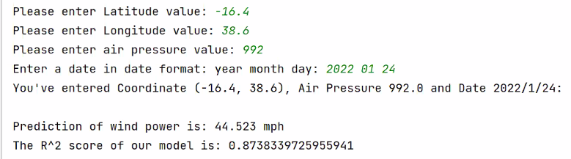

For this case of Tropical Storm ANA we achieve accuracy of 0.98 !
Wow effect
ana-storm

Slide 22
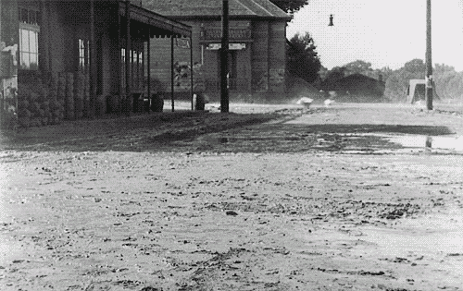

Conclusions
The answers on our research questions are positive – we can predict wind power- by Date, Coordinates and air pressure parameters.
Also we can predict the probability of storm’s strength
Data acquisition
Data cleaning
EDA
ML
CONCLUSIONS

Slide 23



Thanks!
Any questions?
Project Github
Sapir Daga
Rotem Ben Tulila

